Slide 1
الاقتناءات الجديدة لمكتبة كلية العلوم و التكنولوجيا
جامعة مصطفى اسطمبولي معسكر

Slide 2
NEW ACQUISITION OF THE LIBRARY OF THE FACULTY OF SCIENCE TECHNOLOGY MUSTAPHA ISTAMBOULI UNIVERSITY MASCARA

Slide 3
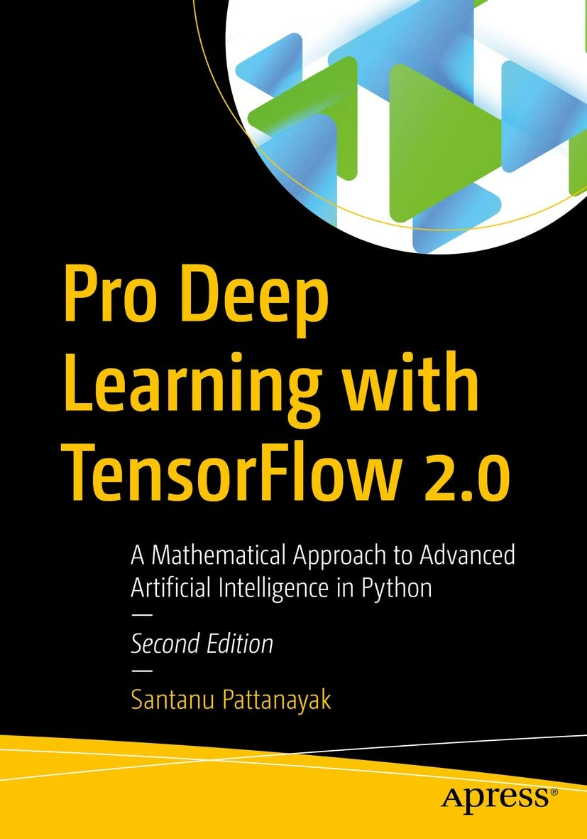
Pro Deep Learning with TensorFlow 2.0: A Mathematical Approach to Advanced Artificial Intelligence in Python
This book builds upon the foundations established in its first edition, with updated chapters and the latest code implementations to bring it up to date with Tensorflow 2.0.
Pro Deep Learning with TensorFlow 2.0 begins with the mathematical and core technical foundations of deep learning. Next, you will learn about convolutional neural networks, including new convolutional methods such as dilated convolution, depth-wise separable convolution, and their implementation. You’ll then gain an understanding of natural language processing in advanced network architectures such as transformers and various attention mechanisms relevant to natural language processing and neural networks in general. As you progress through the book, you’ll explore unsupervised learning frameworks that reflect the current state of deep learning methods, such as autoencoders and variational autoencoders. The final chapter covers the advanced topic of generative adversarial networks and their variants, such as cycle consistency GANs and graph neural network techniques such as graph attention networks and GraphSAGE.
Upon completing this book, you will understand the mathematical foundations and concepts of deep learning, and be able to use the prototypes demonstrated to build new deep learning applications.
What You Will Learn
Understand full-stack deep learning using TensorFlow 2.0
Gain an understanding of the mathematical foundations of deep learning
Deploy complex deep learning solutions in production using TensorFlow 2.0
Understand generative adversarial networks, graph attention networks, and GraphSAGE
Who This Book Is For:
Data scientists and machine learning professionals, software developers, graduate students, and open source enthusiasts

Slide 4

Wireless Security Architecture Designing and Maintaining Secure Wireless for Enterprise
Reduce organizational cybersecurity risk and build comprehensive WiFi, private cellular, and IOT security solutions
Wireless Security Architecture: Designing and Maintaining Secure Wireless for Enterprise offers readers an essential guide to planning, designing, and preserving secure wireless infrastructures. It is a blueprint to a resilient and compliant architecture that responds to regulatory requirements, reduces organizational risk, and conforms to industry best practices. This book emphasizes WiFi security, as well as guidance on private cellular and Internet of Things security.
Readers will discover how to move beyond isolated technical certifications and vendor training and put together a coherent network that responds to contemporary security risks. It offers up-to-date coverage—including data published for the first time—of new WPA3 security, Wi-Fi 6E, zero-trust frameworks, and other emerging trends. It also includes:
Concrete strategies suitable for organizations of all sizes, from large government agencies to small public and private companies
Effective technical resources and real-world sample architectures
Explorations of the relationships between security, wireless, and network elements
Practical planning templates, guides, and real-world case studies demonstrating application of the included concepts
Perfect for network, wireless, and enterprise security architects, Wireless Security Architecture belongs in the libraries of technical leaders in firms of all sizes and in any industry seeking to build a secure wireless network.

Slide 5

Voltage Stability in Electrical Power Systems Concepts, Assessment, and Methods for Improvement
Voltage Stability in Electrical Power SystemsExplore critical topics and the latest research in voltage stability in electric power systems
In Voltage Stability in Electrical Power Systems: Concepts, Assessment, and Methods for Improvement, three distinguished electrical engineers deliver a comprehensive discussion of voltage stability analysis in electrical power systems. The book discusses the concept of voltage stability, effective factors and devices, and suitable system modeling, offering readers an authoritative overview of the subject and strategies to prevent instability in power systems.
The authors explore critical topics such as load and load tap changer (LTC) transformer modeling and the impact of distributed generation and transmission-distribution interactions on voltage stability. They also present practical methods to improve voltage stability.
Readers will also find:
Thorough introductions to voltage stability, effective factors and devices, and suitable systems modeling
Comprehensive explorations of voltage stability assessment methods, including the continuation power flow methods and PV-curve fitting
In-depth explorations of methods of improving voltage stability, including preventive and corrective methods
Fulsome presentations of measurement-based indices and model-based indices of stability assessment
Perfect for engineers and other professionals designing electric power systems, Voltage Stability in Electrical Power Systems: Concepts, Assessment, and Methods for Improvement will also earn a place in the libraries of graduate and senior undergraduate students with an interest in power systems.

Slide 6
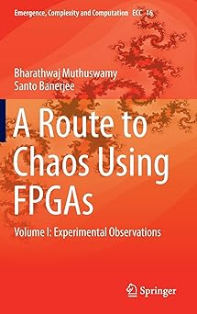
A Route to Chaos Using Fpgas Experimental Observations
The purpose of this introductory book is to couple the teaching of chaotic circuit and systems theory with the use of field programmable gate arrays (FPGAs).
As such, it differs from other texts on chaos: first, it puts emphasis on combining theoretical methods, simulation tools and physical realization to help the reader gain an intuitive understanding of the properties of chaotic systems. Second, the "medium" used for physical realization is the FPGA. These devices are massively parallel architectures that can be configured to realize a variety of logic functions. Hence, FPGAs can be configured to emulate systems of differential equations.
Nevertheless maximizing the capabilities of an FPGA requires the user to understand the underlying hardware and also FPGA design software. This is achieved by the third distinctive feature of this book: a lab component in each chapter. Here, readers are asked to experiment with computer simulations and FPGA designs, to further their understanding of concepts covered in the book.
This text is intended for graduate students in science and engineering interested in exploring implementation of nonlinear dynamical (chaotic) systems on FPGAs.

Slide 7
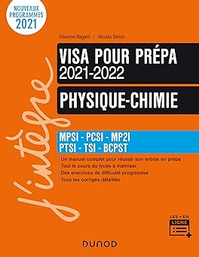
Physique-Chimie - Visa pour la prépa 2021-2022: MPSI-PCSI-MP2I-PTSI-TSI-BCPST (2021-2022)
Vous souhaitez préparer votre entrée en prépa au cours de votre année de Terminale ? Vous êtes en prépa et vous pensez avoir des lacunes sur le programme du lycée ?
Ce court ouvrage vous aidera à maîtriser tous les pré-requis en physique et en chimie.
Il comporte un cours qui fait la synthèse des notions du lycée requises en prépa pour vous aider à démarrer votre année sur des bases solides. Il aborde "en douceur" les premières notions du programme.
Vous y trouverez également un entraînement complet avec des tests de connaissances pour évaluer votre niveau et des exercices à difficulté progressive (avec leur corrigé détaillé) pour vous entraîner.
Cette nouvelle édition intègre la nouvelle section MPII, et est conforme aux nouveaux programmes 2021 des classes prépas.

Slide 8

Renewable Energy Systems for Building Designers: Fundamentals of Net Zero and High Performance Design
Renewable Energy Systems for Building Designers presents a comprehensive introduction to the latest resources and technologies used in high performance and net zero energy buildings, with a practical focus on the design and integration of these systems. This textbook and convenient reference offers a single-source guide to renewable technologies, balancing broad knowledge with the details of implementation crucial for successful sustainable design. It equips students and professionals with foundations and critical information needed to confidently plan for and meet the highest standards of energy efficiency in new construction and retrofitted buildings.
Part I of the book establishes key principles of renewable systems, power production, and design for climate, introducing energy modeling and measurements of performance. Part II focuses in more depth on renewable energy systems, including photovoltaics, heat pumps, solar thermal, and more. Dedicated chapters break down the fundamental concepts behind each renewable technology and present guidelines for configuration and installation including system requirements, equipment specification, sizing, and location of components. Part III discusses topics relevant across renewable systems, including energy storage, control and monitoring, and cost/payback calculation. Part IV comprises case studies of exemplary renewable energy projects.
Features:
Covers resources and technologies including photovoltaics, solar thermal hot water, heat pumps, biomass, wind and microhydro turbines, marine renewable energy, deep cycle rechargeable batteries, and system controllers.
Compiles up-to-date, essential information on designing with renewable systems in one location, organized by technology for easy reference.
Presents clear explanations of all concepts and system aspects, using US/SI units and full-color diagrams and illustrations throughout.
Features case studies of renewable energy systems in completed projects, demonstrating a range of climate specific applications.
Includes study questions, a comprehensive guide to terminology and acronyms, spreadsheets for calculations, system sizing worksheets, and additional online resources.
Renewable Energy Systems for Building Designers: Fundamentals of Net Zero and High Performance Design will serve as an essential introduction and enduring reference for students of architecture, engineering, construction, and building science. Equally valuable as a professional resource, it will quickly become the go-to guide for energy efficient design for practitioners in these areas.

Slide 9

Physique de la turbulence: Des tourbillons aux ondes
Depuis la première expérience historique de Reynolds sur les liquides en 1883, notre compréhension de la turbulence s'est considérablement étendue grâce aux avancées théoriques, numériques, expérimentales et observationnelles. De l'écoulement des fleuves aux plasmas astrophysiques en passant par les ailes d'avion et les ondes gravitationnelles, la turbulence intervient dans de nombreux systèmes physiques. Cet ouvrage se propose de faire découvrir au lecteur les principes fondamentaux qui régissent la physique de la turbulence. La turbulence forte tourbillonnaire et la turbulence faible d'ondes sont les deux régimes que nous rencontrons dans la nature.L'attention des mécaniciens des fluides étant portée sur l'hydrodynamique, c'est généralement le premier régime qui est traité. Cependant, les physiciens s'intéressent à des systèmes bien plus variés où les ondes sont souvent présentes. L'originalité de cet ouvrage est de traiter, à parts égales, la turbulence forte et la turbulence d'ondes. Ce livre offre un vaste tour d'horizon sur la turbulence qui devrait permettre aux chercheurs débutants d'acquérir une connaissance de base sur des sujets à la pointe de la recherche actuelle. Son contenu repose en partie sur un enseignement délivré depuis plusieurs années à l'École polytechnique à des étudiants de Master 2 (Master de Physique des Plasmas sous la tutelle de l'Université Paris-Saclay, l'Institut Polytechnique de Paris et Sorbonne-Université).

Slide 10
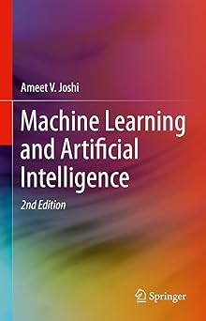
Machine Learning and Artificial Intelligence
The new edition of this popular professional book on artificial intelligence (ML) and machine learning (ML) has been revised for classroom or training use. The new edition provides comprehensive coverage of combined AI and ML theory and applications. Rather than looking at the field from only a theoretical or only a practical perspective, this book unifies both perspectives to give holistic understanding. The first part introduces the concepts of AI and ML and their origin and current state. The second and third parts delve into conceptual and theoretic aspects of static and dynamic ML techniques. The fourth part describes the practical applications where presented techniques can be applied. The fifth part introduces the user to some of the implementation strategies for solving real life ML problems. Each chapter is accompanied with a set of exercises that will help the reader / student to apply the learnings from the chapter to a real-life problem. Completion of these exercises will help the reader / student to solidify the concepts learned.The book is appropriate for students in graduate and upper undergraduate courses in addition to researchers and professionals. It makes minimal use of mathematics to make the topics more intuitive and accessible. The book covers a large gamut of topics in the area of AI and ML and a professor can tailor a course on AI / ML based on the book by selecting and re-organizing the sequence of chapters to suit the needs.

Slide 11

Précis d'électrotechnique - 2e éd.: Cours avec exercices corrigés
Les notions fondamentales du génie électrique sont rappelées en début d'ouvrage avant d'aborder les machines à courant continu, le transformateur monophasé, les systèmes triphasés équilibrés, l'alternateur asynchrone et le moteur asynchrone. Le dernier chapitre est consacré à la sécurité électrique.
Le cours, concis, clair et pédagogique, est ponctué de rubriques "En bref" qui signalent les notions importantes à retenir. Dans chaque chapitre, de nombreux exercices basés sur des situations concrètes permettent de se préparer aux épreuves. Les corrigés, détaillés, mettent l'accent sur la méthodologie. Un chapitre est consacré au problème de la sécurité électrique.

Slide 12
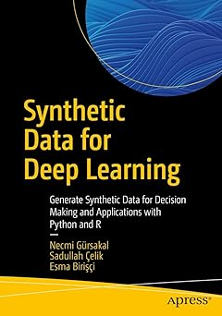
Synthetic Data for Deep Learning Generate Synthetic Data for Decision Making and Applications with Python and R
Data is the indispensable fuel that drives the decision making of everything from governments, to major corporations, to sports teams. Its value is almost beyond measure. But what if that data is either unavailable or problematic to access? That’s where synthetic data comes in. This book will show you how to generate synthetic data and use it to maximum effect.Synthetic Data for Deep Learning begins by tracing the need for and development of synthetic data before delving into the role it plays in machine learning and computer vision. You’ll gain insight into how synthetic data can be used to study the benefits of autonomous driving systems and to make accurate predictions about real-world data. You’ll work through practical examples of synthetic data generation using Python and R, placing its purpose and methods in a real-world context. Generative Adversarial Networks (GANs) are also covered in detail, explaining how they work and their potential applications.After completing this book, you’ll have the knowledge necessary to generate and use synthetic data to enhance your corporate, scientific, or governmental decision making.What You Will LearnCreate synthetic tabular data with R and Python
Understand how synthetic data is important for artificial neural networks
Master the benefits and challenges of synthetic data
Understand concepts such as domain randomization and domain adaptation related to synthetic data generation
Who This Book Is ForThose who want to learn about synthetic data and its applications, especially professionals working in the field of machine learning and computer vision. This book will also be useful for graduate and doctoral students interested in this subject.

Slide 13
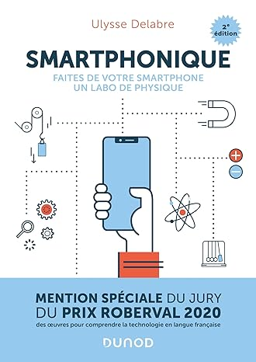
Smartphonique - 2e éd.: Faites de votre smartphone un labo de physique
Nos smartphones sont de véritables concentrés de capteurs : accéléromètres, magnétomètres, capteur de pression, de luminosité… qu’il est possible de détourner de leurs fonctions d’origine, afin d'effectuer des mesures et mener de véritables expériences scientifiques. Votre smartphone devient alors un laboratoire portatif pour expérimenter n’importe où et quand vous voulez.
Après une description des différents capteurs, cet ouvrage explique comment les utiliser pour tester les grands principes de la physique en mécanique, en acoustique, en optique, en thermodynamique, en mécanique des fluides, ou encore en astrophysique. Grâce à l’utilisation d’applications simples et gratuites, il est ainsi possible de mesurer la vitesse du son, de peser la masse de la Terre, de voir et mesurer la taille des cellules, d’étudier le transit d’exoplanètes…
Des rappels théoriques (niveau Licence) permettent au lecteur d’approfondir sa compréhension des phénomènes observés.
Cette deuxième édition a été entièrement révisée et présente les dernières applications disponibles (iOS et Android) ainsi que des nouvelles thématiques.

Slide 14

Super manuel de physique MPSI PCSI PTSI: Tout le semestre 1
Le manuel de physique tout-en-en et en quadri qui exploite de nombreux supports visuels, des expériences réelles et imaginaires et des démonstrations dynamiques, commentées "comme en classe". Cet ouvrage est conforme au nouveau programme du semestre 1 des classes préparatoires scientifiques MPSI, PCSI, PTSI, MPII, TSI1.

Slide 15
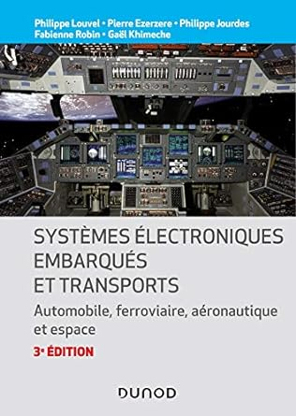
Systèmes électroniques embarqués et transports - 3ed. - Automobile, ferroviaire, aéronautique et esp: Automobile, ferroviaire, aéronautique et espace
embarquée s’est imposée comme une discipline à part entière avec ses spécificités propres. Dans le domaine des transports, elle a su s’adapter aux contingences les plus critiques et aux cahiers des charges les plus exigeants de l’aéronautique, du ferroviaire, de l’automobile et du domaine spatial auquel cette troisième édition, par ailleurs entièrement mise à jour, consacre une partie totalement nouvelle.
Cet ouvrage permet non seulement d’avoir une vision synthétique du secteur, mais donne aussi des revues détaillées de solutions, tant sur les aspects systèmes que sur les aspects composants ou logiciels. Il fait ressortir les similitudes, les différences et les perspectives d’évolution des transports automobile, aéronautique, ferroviaire et spatial à travers de nombreux exemples commentés.

Slide 16

Introduction to Astronomy and Astrophysics
This textbook provides the basic theoretical and practical knowledge of astronomy and astrophysics. It provides an overview from classical astronomy and observational methods to solar physics and astrophysics of stars and galaxies. It concludes with chapters on cosmology, astrobiology, and mathematical and numerical methods. Numerous color illustrations, examples of calculations, and exercises with solutions make this work a useful companion to undergraduate astronomy lectures.
The book is suitable for students of physics and astronomy at teacher training level or in the Bachelor's degree - but also people interested in natural sciences with appropriate basic knowledge of mathematics and physics will find here an appealing introduction to the subject.

Slide 17

Technologies et protocoles Internet
L’objectif de cet ouvrage est de présenter les principes fondateurs à l'origine du succès d'Internet mais également d’identifier leurs limitations. Il donne un panorama complet et précis des technologies et des protocoles qui ont présidé à la conception originelle d'Internet et des ajouts qui ont accompagné ses évolutions.
Cet ouvrage s’adresse aux étudiants et aux élèves-ingénieurs engagés dans un cursus scientifique et technologique pluridisciplinaire. Sont également concernés les enseignants à la recherche d’un ouvrage compagnon qui accompagnera leurs étudiants en y trouvant plusieurs exercices types corrigés.

Slide 18
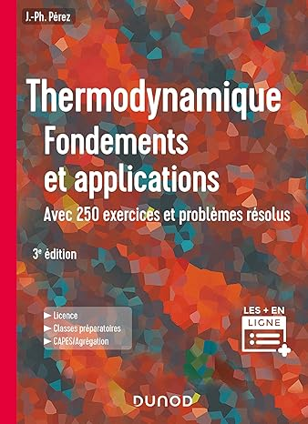
Thermodynamique - 3e éd. - Fondements et applications, avec 250 exercices et problèmes résolus: Fondements et applications, avec 250 exercices et problèmes résolus
Ce cours de thermodynamique est composé de trois parties. La première, grâce à une analyse microscopique simple et en s'appuyant largement sur l'équation-bilan d'une grandeur extensive, exprime les deux premiers principes de la thermodynamique. La deuxième partie présente des compléments et énonce l'interprétation statistique de l'entropie. La dernière, qui débute avec l'étude des gaz parfaits de fermions et de bosons, contient de nombreux approfondissements. Ce cours est découpé en leçons progressives, quasi autonomes, où les exemples, les exercices et les problèmes (résolus) ont été choisis pour montrer l'aspect à la fois fondamental et technique de la thermodynamique. Des solutions complémentaires et des programmes de simulation sont proposés sur le site web dunod.com.

Slide 19

Thermodynamique chimique
Ce manuel contient l'essentiel du cours de la thermodynamique chimique (Energie interne, enthalpie, entropie, etc...) pour les étudiants du premier cycle universitaire. Afin de favoriser une assimilation rapide, j'ai donné des exercices corrigés bien détaillés. Enfin, j'espère que ce travail sera un outil efficace pour les étudiants.Je serai reconnaissant aux collègues et aux étudiants qui voudront faire part de leurs critiques, suggestions et remarques.

Slide 20

Aide Mémoire Électricité - Électronique de commande et de puissance Électrotechnique
Cette nouvelle édition, entièrement révisée et complétée, rassemble les connaissances de base du secteur industriel dans le domaine de l'électricité, de l'électronique et de l'électrotechnique. Destiné aux lycéens et étudiants des formations technologiques et professionnelles ainsi qu'aux professionnels en activité, il a été conçu comme un complément aux ouvrages du domaine. Seules des connaissances de base en mathématiques sont nécessaires à sa compréhension.

Slide 21

Aide-mémoire - Hydraulique industrielle
Cet aide-mémoire regroupe toutes les données théoriques et technologiques sur l’hydraulique industrielle, illustrées de nombreux schémas et tableaux récapitulatifs et d’une centaine de cas concrets. Il aborde successivement les points suivants :• Physique des fluides.• Composants et symboles hydrauliques.• Matériels hydrauliques.• Vérins hydrauliques.• Électrohydraulique.Cette approche à la fois fondamentale et très pratique conviendra aux ingénieurs et techniciens en mécanique ainsi qu’aux étudiants et élèves-ingénieurs qui souhaitent acquérir une meilleure compréhension de la technologie hydraulique

Slide 22

Analyse numérique matricielle - Méthodes et algorithmes, exercices et problèmes corrigés
Cet ouvrage présente un panorama de problèmes abordés en analyse numérique et se destine auxaux élèves d'écoles d'ingénieurs, aux étudiants de Licence, de Master en mathématiques appliquées, mécanique et informatique.Le cours est illustré par des exercices corrigés, des exemples numériques et des algorithmes avec programmation Matlab. Ce livre vise à être un « bon compagnon » du lecteur motivé par le calcul scientifique.

Slide 23
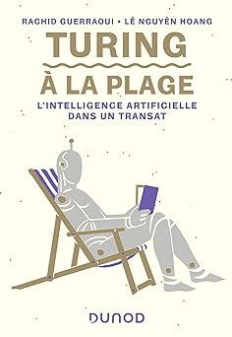
Turing à la plage - L'intelligence artificielle dans un transat L'intelligence artificielle dans un transat
Les humains seront-ils un jour dominés par des algorithmes? Installez-vous confortablement dans un transat, et laissez-vous guider sur le chemin menant des premières idées du génie anglais Alan Turing aux capacités affolantes des ordinateurs quantiques et aux promesses de l'intelligence articielle. Les progrès sont immenses mais les obstacles encore nombreux.Au moment de quitter votre transat, vous ne regarderez plus votre ordinateur de la même manière...

Slide 24
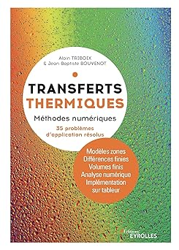
Transferts thermiques Méthodes numériques. 35 problèmes d'application résolus
Destiné aux futurs professionnels de l'industrie et de la construction, ce manuel illustre l'ensemble des connaissances théoriques par des cas d'études (30 problèmes résolus). Il complète G67944 (février 2021). Les auteurs se sont particulièrement attachés à mettre en oeuvre des méthodes numériques permettant d'utiliser un tableur. La démarche décrite par les auteurs permet de maîtriser les hypothèses et les modèles en les adaptant à la précision recherchée. Elle repose sur des modèles analytiques et on l'apprend ici en étudiant des exemples originaux

Slide 25
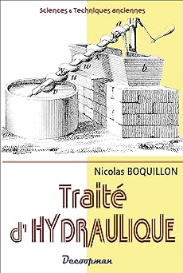
Traité d'hydraulique
L’eau est un élément extraordinaire : indispensable à la vie sur Terre, elle peut également servir de moteur dans de très nombreuses applications.Démonstration en est faite dans ce petit traité qui explique, à travers divers procédés et appareils, la puissance énergétique de l’eau utilisée à des fins mécaniques.La vis d’Archimède, la roue persanne, la pompe à chaîne, les pompes refoulantes ou aspirantes, les béliers hydrauliques, etc... décrits dans cet ouvrage montrent à quel point l’ingéniosité de l’homme, alliée à la puissance mécanique de l’eau ont pu créer des prodiges.

Slide 26
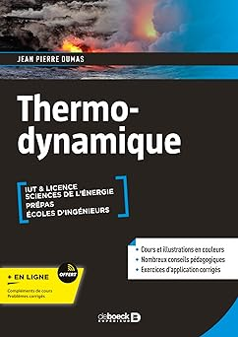
Thermodynamique Cours, exercices et problèmes corrigés - Licence, IUT, Prépas
Un cours moderne et complet de Thermodynamique réalisé en couleur et accompagné d'exercices intégralement corrigés pour les trois premières années de l’enseignement supérieur.
Science moderne et universelle, la thermodynamique n’en demeure pas moins complexe pour de nombreux étudiants. Afin de faciliter son apprentissage, ce manuel – réalisé en couleur – a été rédigé avec une rare cohérence dans les notations, les dénominations de grandeurs ou de fonctions et les méthodes de calcul.Il aborde ainsi l’analyse des principes, les propriétés physiques ou chimiques des gaz parfaits ou réels, les transformations de phases des corps purs ou des solutions binaires même complexes et les lois spécifiques aux systèmes ouverts. Un chapitre sur la thermodynamique des processus irréversibles justifie le ton général privilégiant les transformations irréversibles créatrices d’évolutions. Un autre chapitre présente les enjeux de l’énergétique si prégnants pour l’avenir.Ce livre est destiné à tous les étudiants des UFR de sciences (licence et maîtrise), ceux des IUT (départements Génie thermique et énergie, Mesures physiques, Génie chimique-Génie des procédés, Chimie…), aux élèves des classes préparatoires scientifiques et à ceux des écoles d’ingénieurs dont la spécialité concerne l’énergie, la thermique industrielle ou l’environnement.
Sommaire :
Avant-propos – Introduction1. Définitions générales – 2. Principes de la thermodynamique – 3. Thermodynamique des processus irréversibles – 4. Affinité – 5. Notions de thermodynamique des solutions – 6. Gaz parfaits – Systèmes idéaux – 7. Gaz réels – Systèmes non-idéaux – 8. Équilibre de phases des corps purs – 9. Troisième principe de la thermodynamique – 10. Équilibre de phases des binaires – 11. Thermodynamique des systèmes ouverts – 12. Énergétique – 13. Tableaux récapitulatifsAnnexe : rappels mathématiquesBibliographie – Inde

Slide 27

Appartements d'Architectes chics et contemporains
Découvrez de superbes appartements dans les grandes cités du monde entier, décorés avec goût par les meilleurs architectes d'intérieur

Slide 28
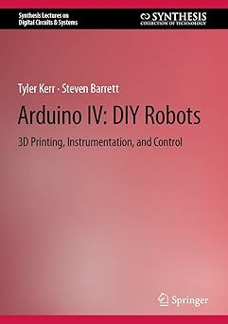
Arduino IV DIY Robots 3D Printing, Instrumentation, and Control (Synthesis Lectures on Digital Circuits & Systems)
This book gives a step-by-step introduction to designing and building your own robots. As with other books in the Arduino series, the book begins with a quick overview of the Arduino Integrated Development Environment (IDE) used to write sketches, and the hardware systems aboard the Arduino UNO R3 and the Mega 2560 Rev 3. The level of the text makes it accessible for students, hobbyist and professionals' first introduction to both Arduino and Robotics. This book will be accessible by all levels of students, advanced hobbyists and engineering professionals, whether using as a self-reference or within a structure design laboratory. The text then examines the many concepts and characteristics common to all robots. In addition, throughout the book , reasonably priced, easily accessible and available off-the-shelf robots are examined. Examples include wheeled robots, tracked robots and also a robotic arm. After a thorough and easy to follow Arduino IDE and hardware introduction, the book launches into “do it yourself” or DIY concepts. A unique feature of the book is to start with a hands-on introduction to low cost 3D printing. These concepts will allow you to design and print your own custom robot parts and chassis. We then explore concepts to sense a robot's environment, move the robot about and provide a portable power source. We conclude with a several DIY robot projects.

Slide 29
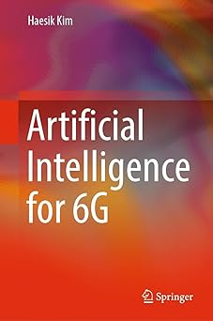
Artificial Intelligence for 6G (English Edition)
This textbook introduces Artificial Intelligence (AI) techniques for wireless communications and networks, helping readers to find solutions for communications and network problems using AI.

Slide 30
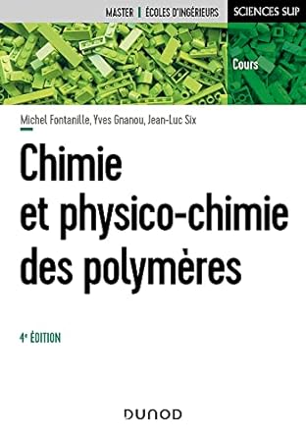
Chimie et physico-chimie des polymères - 4e éd
Cet ouvrage s’adresse principalement aux étudiants en Master de chimie et de physique-chimie ainsi qu’aux élèves des écoles d’ingénieurs. Il intéressera aussi les chercheurs et tous ceux qui utilisent les polymères et souhaitent optimiser le choix de ces matériaux.Cette troisième édition présente l’élaboration, la structure et l’essentiel des propriétés chimiques et physiques des systèmes macromoléculaires, notamment leurs propriétés électriques dont l’importance économique croît de jour en jour.Le livre insiste sur les spécificités liées à l’état macromoléculaire, tant au niveau de la synthèse des polymères que du point de vue de leur comportement macroscopique. Il établit le lien entre la variété des structures potentiellement accessibles et l’éventail des propriétés qui en découlent.

Slide 31

Géochimie des eaux continentales Milieux naturels et anthropisés
Ce livre se destine principalement aux étudiants de licence et de master francophones désireux de comprendre les mécanismes de régulation de la composition des eaux continentales. Il peut aussi être une aide pour les gestionnaires de la qualité des eaux de surface.
Cet ouvrage présente les notions indispensables à la compréhension de la géochimie des eaux illustrées par des exercices corrigés.

Slide 32
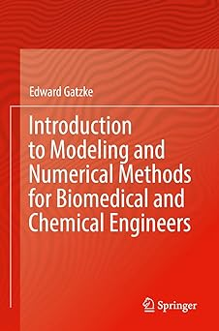
Introduction to Modeling and Numerical Methods for Biomedical and Chemical Engineers
This textbook introduces the concepts and tools that biomedical and chemical engineering students need to know in order to translate engineering problems into a numerical representation using scientific fundamentals. Modeling concepts focus on problems that are directly related to biomedical and chemical engineering. A variety of computational tools are presented, including MATLAB, Excel, Mathcad, and COMSOL, and a brief introduction to each tool is accompanied by multiple computer lab experiences. The numerical methods covered are basic linear algebra and basic statistics, and traditional methods like Newton's method, Euler Integration, and trapezoidal integration. The book presents the reader with numerous examples and worked problems, and practice problems are included at the end of each chapter.

Slide 33
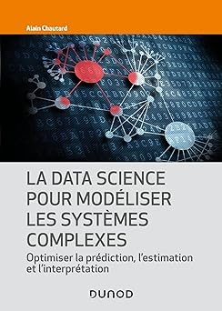
La Data Science pour modéliser les systèmes complexes Optimiser la prédiction, l'estimation et l'interprétation
La data science est devenue un outil de prévision et d’aide à la décision indispensable aux ingénieurs, aux chercheurs et aux responsables en charge de la gestion des projets et des processus.Toutefois, son application à des systèmes complexes exige de dépasser les méthodes linéaires de modélisation généralement appliquées. En effet, si ces méthodes fonctionnent dans la plupart des environnements, elles présentent d’importants biais dès lors que l’on a affaire à des systèmes complexes (météorologie, physique non linéaire, économétrie, finance, etc.).En s’appuyant sur trois cas concrets représentatifs (environnement physique, marchés financiers, gestion de projet), cet ouvrage illustre comment exploiter les données de systèmes complexes pour construire des modèles maîtrisables, exploitables et performants en termes de prédiction, d’estimation et d’interprétation. Il offre une réflexion globale sur les spécificités des systèmes complexes ainsi que des outils concrets pour mieux les interpréter.

Slide 34

De la chimie des solutions à lélectrochimie - Thermodynamique et cinétique électrochimiques
Cet ouvrage présenteles bases de la thermodynamique et la cinétique électrochimiques, illustrées de nombreux exemples de générateurs et d’électrolyseurs industriels et accompagnées d’exercices corrigés.
Il s'adresse aux étudiants en licence, master, élèves des CPGE, élèves-ingénieurs, candidats au CAPES et à l’agrégation, et tout autodidacte intéressé par le stockage et l’utilisation de l’énergie électrique.

Slide 35
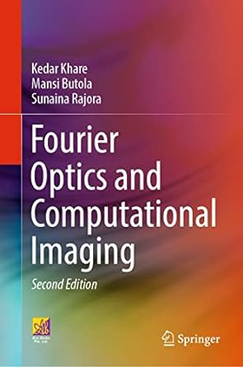
Fourier Optics and Computational Imaging
The book is designed to serve as a textbook for advanced undergraduate and graduate students enrolled in physics and electronics and communication engineering and mathematics. The book provides an introduction to Fourier optics in light of new developments in the area of computational imaging over the last couple of decades. There is an in-depth discussion of mathematical methods such as Fourier analysis, linear systems theory, random processes, and optimization-based image reconstruction techniques. These techniques are very much essential for a better understanding of the working of computational imaging systems. It discusses topics in Fourier optics, e.g., diffraction phenomena, coherent and incoherent imaging systems, and some aspects of coherence theory. These concepts are then used to describe several system ideas that combine optical hardware design and image reconstruction algorithms, such as digital holography, iterative phase retrieval, super-resolution imaging, point spread function engineering for enhanced depth-of-focus, projection-based imaging, single-pixel or ghost imaging, etc. The topics covered in this book can provide an elementary introduction to the exciting area of computational imaging for students who may wish to work with imaging systems in their future careers.

Slide 36
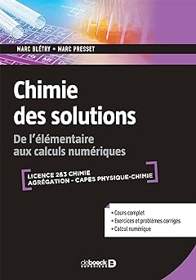
Chimie des solutions De l'élémentaire aux calculs numériques
Cet ouvrage présente les techniques de détermination des équilibres de manière unifiée, des approximations usuelles jusqu'au calcul numérique, en introduisant les méthodes de mathématiques appliquées nécessaires.La détermination des équilibres en solution est essentielle à tout travail en chimie, depuis la chimie analytique jusqu'à la géochimie en passant par l'industrie chimique, les problèmes de corrosion, etc. Cet ouvrage présente les techniques de détermination des équilibres de manière unifiée, depuis les approximations usuelles (méthode des réactions prépondérantes) jusqu'au calcul numérique, en introduisant les méthodes de mathématiques appliquées nécessaires ainsi que leur mise en œuvre.Un grand nombre d'exercices sont proposés en fin de chapitre.

Slide 37
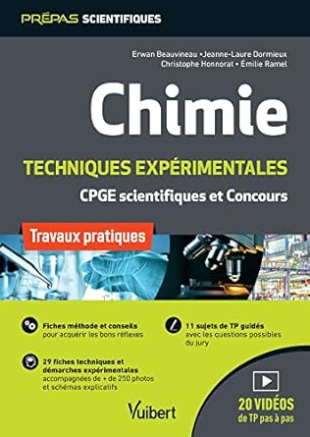
Chimie. Travaux pratiques et techniques expérimentales TP pour les classes préparatoires scientifiques (CPGE) et les concours
Le seul ouvrage du marché en chimie proposant des TP, les techniques associées et des vidéos explicatives.Rassemblant en un seul volume :
des fiches sur les grands principes et savoir-faire à maîtriser en TP (sécurité, méthode de travail, rappels de calculs de base, rédaction d’un compte rendu d’expérience, etc.) ;
des fiches méthodologiques et techniques sur les démarches expérimentales et le matériel à connaître (pesée, dilution, utiliser un Dean-Stark, calculer un rendement, etc.) ;
de nombreux sujets de TP avec tous les corrigés détaillés, accompagnés de conseils pour bien organiser sa paillasse, lire et comprendre le sujet, répondre aux questions et réaliser les expériences, cet ouvrage de chimie est destiné aux étudiants des classes préparatoires scientifiques (CPGE) et à tous ceux souhaitant préparer une épreuve de Travaux Pratiques. Il propose l’intégralité des techniques expérimentales à connaître pour l’épreuve de travaux pratiques des concours.
Des vidéos de l'ensemble des techniques seront disponibles sur le site Vuibert et via des flashcodes dans l'ouvrage pour expliquer les démarches expérimentales.

Slide 38
De la chimie des solutions à lélectrochimie - Thermodynamique et cinétique électrochimiques
Cet ouvrage présenteles bases de la thermodynamique et la cinétique électrochimiques, illustrées de nombreux exemples de générateurs et d’électrolyseurs industriels et accompagnées d’exercices corrigés.
Il s'adresse aux étudiants en licence, master, élèves des CPGE, élèves-ingénieurs, candidats au CAPES et à l’agrégation, et tout autodidacte intéressé par le stockage et l’utilisation de l’énergie électrique.

Slide 39

Electricité en régime sinusoïdal L'essentiel pour l'étudiant
L’essentiel à savoir sur les circuits électriques en régime sinusoïdal, sur leur modélisation complexe, sur les théorèmes fondamentaux et sur les méthodes à utiliser pour résoudre n’importe quel problème d’électricité en régime sinusoïdal.

Slide 40
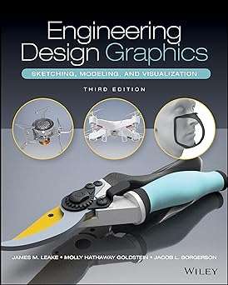
Engineering Design Graphics Sketching, Modeling, and Visualization
The most accessible and practical roadmap to visualizing engineering projects
In the newly revised Third Edition of Engineering Design Graphics: Sketching, Modeling, and Visualization, renowned engineering graphics expert James Leake delivers an intuitive and accessible guide to bringing engineering concepts and projects to visual life. Including updated coverage of everything from freehand sketching to solid modeling in CAD, the author comprehensively discusses the tools and skills you'll need to sketch, draw, model, document, design, manufacture, or simulate a project.

Slide 41

Essential Ordinary Differential Equations
This textbook offers an engaging account of the theory of ordinary differential equations intended for advanced undergraduate students of mathematics. Informed by the author's extensive teaching experience, the book presents a series of carefully selected topics that, taken together, cover an essential body of knowledge in the field. Each topic is treated rigorously and in depth.The book begins with a thorough treatment of linear differential equations, including general boundary conditions and Green's functions. The next chapters cover separable equations and other problems solvable by quadratures, series solutions of linear equations and matrix exponentials, culminating in Sturm-Liouville theory, an indispensable tool for partial differential equations and mathematical physics. The theoretical underpinnings of the material, namely, the existence and uniqueness of solutions and dependence on initial values, are treated at length. A noteworthy feature of this book is the inclusion of project sections, which go beyond the main text by introducing important further topics, guiding the student by alternating exercises and explanations. Designed to serve as the basis for a course for upper undergraduate students, the prerequisites for this book are a rigorous grounding in analysis (real and complex), multivariate calculus and linear algebra. Some familiarity with metric spaces is also helpful. The numerous exercises of the text provide ample opportunities for practice, and the aforementioned projects can be used for guided study. Some exercises have hints to help make the book suitable for independent study.

Slide 42

Fundamentals of IoT Communication Technologies (Textbooks in Telecommunication Engineering)
This textbook explores all of the protocols and technologies essential to IoT communication mechanisms. Geared towards an upper-undergraduate or graduate level class, the book is presented from a perspective of the standard layered architecture with special focus on protocol interaction and functionality. The IoT protocols are presented and classified based on physical, link, network, transport and session/application layer functionality. The author also lets readers understand the impact of the IoT mechanisms on network and device performance with special emphasis on power consumption and computational complexity. Use cases – provided throughout – provide examples of IoT protocol stacks in action. The book is based on the author’s popular class “Fundamentals of IoT” at Northeastern University. The book includes examples throughout and slides for classroom use. Also included is a 'hands-on’ section where the topics discussed as theoretical content are built as stacks in the context of an IoT network emulator so readers can experiment.

Slide 43
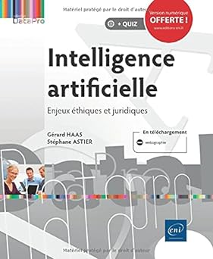
Intelligence artificielle - Enjeux éthiques et juridiques
Après l'avènement de la société de l'information et la digitalisation de pans entiers d'activités de notre société, la révolution de l'IA est en marche. Cette (r)évolution s'accompagne d'une médiatisation tous azimuts, oscillant entre fantasmes dystopiques et électrochocs nécessaires d'une opinion publique souvent perdue au sein de ce maelström. Une chose est sûre, l’IA occupe les pensées et vient bouleverser notre droit.Le présent guide propose une réflexion pragmatique et pratique sur l’impact des progrès techniques associés à l’intelligence artificielle dans nos sociétés dites modernes. Les questions sont nombreuses : comment appréhender l’IA ? Comment en réguler l’utilisation ? Comment accompagner les extraordinaires promesses de l’IA tout en se protégeant contre les risques incroyables qu’elle génère ?Au travers d’exemples concrets touchant aussi bien la sphère privée individuelle, la sphère professionnelle de l’entreprise ou la sphère publique étatique, ce guide s’attache à éclairer le lecteur sur ce qu’est l’IA et ce qu’elle n’est pas ; sur les risques actuels et à venir d’une IA sans limite et sans droit.Les questions éthiques et juridiques seront au cœur de cette réflexion transversale poussant notre droit dans ses limites. Mais n’est-ce pas avant tout un éternel recommencement ? Peut-on parler de vide juridique comme ceux qui se trompaient lors de la naissance d’internet ? Certainement pas. Comme nous le verrons, c’est bien en appliquant ses fondamentaux que le professionnel du droit participera activement et efficacement à la régulation et au développement de l’intelligence artificielle. L’IA est ainsi soit objet soit acteur de la relation contractuelle. Il nous appartient dans ce contexte de clarifier sa responsabilité en tant que cause ou acteur du dommage. Nous devrons aussi nous interroger sur le sort des créations produites par l’IA ou encore sur son impact au regard des activités de chacun, des compétences et des métiers.Ainsi, ce guide s’adresse généralement à tous ceux qui s’intéressent à l’IA et plus particulièrement aux professionnels du droit qui en auront l’utilité.

Slide 44
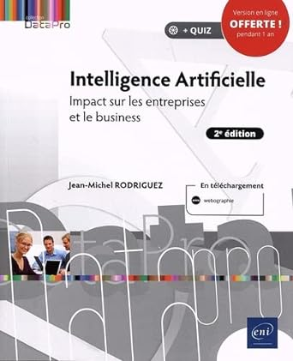
Intelligence Artificielle - Impact sur les entreprises et le business (2e édition) Impact sur les entreprises et le business (2e édition)
L'Intelligence Artificielle ou IA est au coeur de nombreux débats et est le fer de lance de beaucoup d’entreprises. Il ne se passe plus une journée sans qu'une communication ne soit faite sur une nouvelle intelligence artificielle capable d'en faire plus que la précédente. La guerre industrielle est lancée et on peut facilement imaginer qu'elle ne se terminera que par une entité artificielle égale ou supérieure à l'humain. C'est dans ce nouveau monde qui se prépare qu'apparaît la branche cognitive de l'intelligence artificielle qui s'appuie sur des domaines et outils tels que l'apprentissage et l'auto-apprentissage, les réseaux de neurones, la langue naturelle, les arbres de décision dont les objectifs sont de déduire des faits marquants, repérer des motifs, prédire des tendances, imaginer de nouveaux services à mettre en place et ainsi aider l'humain à décider. Mais cela ne se fait pas sans inquiétudes, tout d'abord les biais qui peuvent fausser les interprétations et donc les décisions et ensuite l'impact que l'intelligence artificielle va avoir sur nos activités, nos rôles et nos métiers.

Slide 45
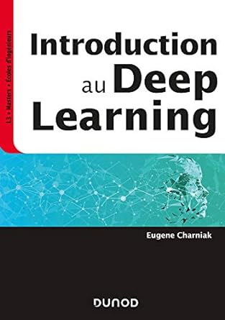
Introduction au Deep Learning
Cet ouvrage s’adresse aux étudiants en fin de licence et en master d’informatique ou de maths appliquées, ainsi qu’aux élèves ingénieurs.L’apprentissage profond (deep learning) a révolutionné l’intelligence artificielle et s’est très rapidement répandu dans de nombreux domaines d’activité.Grâce à une approche « orientée projet », ce livre a pour but d’expliquer les bases du deep learning, depuis les réseaux de neurones à propagation avant jusqu’aux réseaux non supervisés.Conçu comme un manuel d’apprentissage synthétique, avec cours et exercices, il s’appuie sur des exemples dans des domaines comme la vision par ordinateur, la compréhension des langages naturels ou l’apprentissage par renforcement.Ces exemples sont étudiés avec le logiciel TensorFlow.Les notions théoriques sont illustrées et complétées par une quarantaine d’exercices, dont la moitié sont corrigés.

Slide 46
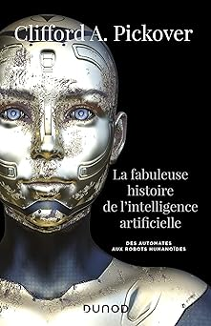
La fabuleuse histoire de l'intelligence artificielle - Des automates aux robots humanoïdes Des automates aux robots humanoïdes
Des robots médiévaux à la reconnaissance faciale, en passant par les réseaux neuronaux artificiels, Clifford Pickover vous raconte en cent inventions l’histoire fascinante de l’intelligence artificielle.Organon d’Aristote, machine de Babbage, ENIAC, Hal 9000, Deep Blue ou encore AlphaGo, l’ouvrage explore les applications de l’IA dans des domaines aussi divers que l’informatique, la médecine, la culture populaire ou la philosophie.Plongez dans ce livre et laissez-vous guider dans un vaste voyage à travers le monde pour comprendre les origines de l’intelligence artificielle, son avenir et ce qu’elle signifie pour l’humanité.

Slide 47
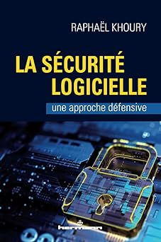
La sécurité logicielle Une approche défensive
La sécurité logicielle désigne l'ensemble des théories, des pratiques, des vérifications et des prudences que devraient utiliser les programmeurs afin que les systèmes qu'ils développent soient aussi sécuritaires que possible. Cet aspect de la sécurité informatique est souvent négligé. Cette attitude est regrettable, car, si le code d'un programme n'est pas développé avec soin, les stratégies de sécurité telles que la cryptographie ou les outils de sécurité des réseaux seront insuffisantes pour assurer la sécurité du système. Dans cet ouvrage, nous présentons les principes théoriques ainsi que les approches pratiques qui mènent à la création de codes robustes et sécuritaires. Nous utilisons une approche pédagogique originale par laquelle les principes sous-jacents à la sécurité des programmes sont illustrés par des exemples d'attaques réelles, et suivis de conseils que le programmeur peut mettre en pratique sans délai. Le livre présente aussi au lecteur les avancées scientifiques récentes de la recherche dans ce domaine.

Slide 48

Les énergies renouvelables
Ce livre détaille les principales sources d'énergie renouvelables - solaire, éolienne, hydroélectrique et biomasse - ainsi que celles qui sont moins développées - géothermie, marée et vagues. L'auteur expose les défis que représente l'intégration des énergies renouvelables dans les réseaux électriques, ainsi que la nécessité du stockage de l'énergie. Il examine également les efforts internationaux visant à soutenir les énergies renouvelables et à lutter contre le changement climatique, et détaille les récentes innovations en matière de production d'énergie éolienne et solaire, de stockage et de conversion de l'électricité en gaz pour le chauffage propre.

Slide 49

Les environnements froids Glaciaire et periglaciaire - Cours et exercices corrigés - Master
Rédigé à l'attention des étudiants en Master des filières Sciences de la Terre et Sciences de l'Environnement, ce manuel de référence étudie le fonctionnement physique et biologique des milieux froids, passés et présents, prenant notamment en compte l'intégration de la biosphère dans le contexte des changements climatiques.Il comprend un cours complet, illustré de nombreux documents inédits (schémas, cartes, diagrammes et photographies), des exercices d'applications corrigés ainsi qu'un glossaire de plus de 500 termes spécialisés.Sommaire :1. Le Quaternaire et l'Holocène2. Propriétés mécaniques et thermiques : le froid, une dessiccation orientée3. Le monde vivant4. La végétation et les sols5. Les avatars de la banquise et la dynamique glacielle6. Le monde glaciaire7. Le pergélisol, dynamique et extension8. La dynamique périglaciaire vraie9. L'environnement azonal et l'évolution paraglaciaire10. Bilans sédimentaires quaternaires et stratigraphie séquentielleConclusionCorrigés des exercicesGlossaireBibliographie

Slide 50

L'évaluation des impacts sur l'environnement Processus, acteurs et pratique pour un développement durable
L'évaluation environnementale et, en particulier, l'évaluation des impacts sur l'environnement (EIE) sont des outils majeurs de développement durable. Elles permettent d'inscrire l'environnement dans les processus de décision à diverses échelles, depuis le niveau stratégique de la planification jusqu'à la gestion des opérations. L'évaluation des impacts sur l'environnement - Processus, acteurs et pratique pour un développement durable, quatrième édition, initie le lecteur à l'EIE et au développement durable dans une perspective interdisciplinaire et résolument francophone. L'ouvrage introduit les concepts clés du sujet, puis décrit et approfondit le processus et la pratique de l'EIE, situant la démarche dans un contexte sociopolitique où les acteurs sont en constante interaction et en apprentissage. Il discute tant des méthodes et des outils de réalisation et d'examen d'une EIE que de ceux requis pour l'exercice de la participation publique et pour l'introduction de l'analyse "développement durable" dans l'EIE, y compris la prise en compte des changements climatiques et de la biodiversité ; ces derniers aspects font d'ailleurs l'objet d'un nouveau chapitre. En outre, l'ouvrage décrit l'évaluation environnementale stratégique. Un site Web d'accompagnement collige des études de cas et fournit un carnet de liens Internet vers les sites, principalement francophones, les plus pertinents à l'exercice de la profession. Cet ouvrage est destiné aux étudiants inscrits dans un programme universitaire en environnement ou en développement durable ainsi qu'a toute personne impliquée dans un processus d'évaluation d'un projet en développement ou intéressée par le sujet, qu'elle soit un professionnel de l'ElE, un maître d'ouvrage, un décideur, un membre d'organisation ou un membre du public.

Slide 51

L'INTELLIGENCE ARTIFICIELLE REFLEXION POUR UNE ETHIQUE RESPONSABLE
Les algorithmes et l'intelligence artificielle sont partout. Ce sont eux qui suggèrent des «?amis?» et des activités sur les réseaux sociaux, qui ajustent les prix sur les sites d'e-commerce et indiquent aux clients le produit à acheter, qui affectent les étudiants dans les établissements d'enseignement supérieur, qui conduisent les automobiles autonomes, qui établissent les bulletins météo, qui répondent de façon quasiment spontanée à une demande de clients sous la forme d'un chatbot, etc.

Slide 52

L'intelligence artificielle, tu connais Dès 13 ans
Au carrefour de plusieurs disciplines (mathématiques, informatique, sciences cognitives...), l'intelligence artificielle connaît actuellement un essor foudroyant et annonce une révolution technologique dans les années à venir. Elle nécessite de nouvelles compétences, crée de nouveaux métiers, mais risque d'en supprimer aussi. Il est donc temps de faire entrer l'IA à l'école afin d'anticiper ses impacts sur l'emploi et donner aux jeunes toutes les clés pour leur orientation professionnelle. Destiné aux jeunes de 13 ans+, ce manuel est un petit livre d'introduction à l'intelligence artificielle. Avec des mots simples et clairs, il en détaille les grands principes, les principales applications, ses dangers et son devenir. Il est complété par trois ateliers pratiques d'intelligence artificielle où l'ado sera amené à coder. Un livre de vulgarisation pour comprendre l'IA, l'utiliser et susciter des vocations.

Slide 53
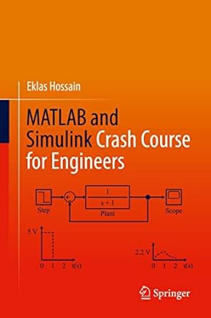
MATLAB and Simulink Crash Course for Engineers
MATLAB and Simulink Crash Course for Engineers is a reader-friendly introductory guide to the features, functions, and applications of MATLAB and Simulink. The book provides readers with real-world examples, exercises, and applications, and offers highly illustrated, step-by-step demonstrations of techniques for the modelling and simulation of complex systems. MATLAB coverage includes vectors and matrices, programs and functions, complex numbers, visualization, solving equations, numerical methods, optimization problems, and graphical user interfaces. The Simulink coverage includes commonly used Simulink blocks, control system simulation, electrical circuit analysis, electric power systems, power electronics, and renewable energy technology. This powerful tutorial is a great resource for students, engineers, and other busy technical professionals who need to quickly acquire a solid understanding of MATLAB and Simulink.

Slide 54

Microwave Plasma Sources and Methods in Processing Technology
In Microwave Plasma Sources and Methods in Processing Technology, the authors deliver a comprehensive introduction to microwaves and microwave-generated plasmas. Ideal for anyone interested in non-thermal gas discharge plasmas and their applications, the book includes detailed descriptions, explanations, and practical guidance for the study and use of microwave power, microwave components, plasma, and plasma generation.
This reference includes over 130 full-color diagrams to illustrate the concepts discussed within. The distinguished authors discuss the plasmas generated at different levels of power, as well as their applications at reduced, atmospheric and higher pressures. They also describe plasmas inside liquids and plasma interactions with combustion flames.
Microwave Plasma Sources and Methods in Processing Technology concludes with an incisive exploration of new trends in the study and application of microwave discharges, offering promising new areas of study.
The book also includes:
• A thorough introduction to the basic principles of microwave techniques and power systems, including a history of the technology, microwave generators, waveguides, and wave propagation
• A comprehensive exploration of the fundamentals of the physics of gas discharge plasmas, including plasma generation, Townsend coefficients, and the Paschen curve
• Practical discussions of the interaction between plasmas and solid surfaces and gases, including PVD, PE CVD, oxidation, sputtering, evaporation, dry etching, surface activation, and cleaning
• In-depth examinations of microwave plasma systems for plasma processing at varied parameters
Perfect for researchers and engineers in the microwave community, as well as those who work with plasma applications, Microwave Plasma Sources and Methods in Processing Technology will also earn a place in the libraries of graduate and PhD students studying engineering physics, microwave engineering, and plasmas.

Slide 55
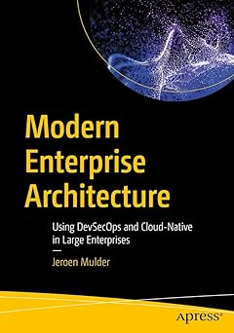
Modern Enterprise Architecture Using DevSecOps and Cloud-Native in Large Enterprises
Enterprise Architecture (EA) frameworks such as TOGAF and Zachman are still valid, but enterprise architects also need to adapt to the new reality of agile, DevOps, and overall disruption through digital transformation. This book will help do just that.The Change to Modern Enterprise Architecture will teach you how to use known frameworks in the new world of digital transformation. Over the course of the book, you'll learn how modern EA is helping drive strategic business decisions, create continuous and agile (“floating”) architecture for scalability, and how to address quality and speed in architecture using and integrating DevSecOps frameworks in EA.
This book is divided into three parts: the first explains what modern enterprise architecture is and why it’s important to any business. It covers the different EA frameworks and explains what they are. In the second part, you will learn how to integrate modern development frameworks into EA, and why this knowledge will enable you to deftly respond to various business challenges. The final section of the book is all about scaling the enterprise using modern enterprise architecture. You will also see how the role of the enterprise architect is changing and how to remain in control of your architecture. Upon completing this book, you'll understand why the enterprise architect is no longer just a role overseeing the architecture strategy of a business, but has become more of a leader in driving engineering excellence. What You'll LearnIntegrate DevSecOps as artifact to modern EA
Use Enterprise Architecture to scale up your business
Understand the changing role of the enterprise architect
Define a floating architecture to enhance business agilityWho This Book Is ForEnterprise architects, IT architects, lead engineers, business architects, business leaders, product managers

Slide 56

Out-of-order Parallel Discrete Event Simulation for Electronic System-level Design
This book offers readers a set of new approaches and tools a set of tools and techniques for facing challenges in parallelization with design of embedded systems. It provides an advanced parallel simulation infrastructure for efficient and effective system-level model validation and development so as to build better products in less time. Since parallel discrete event simulation (PDES) has the potential to exploit the underlying parallel computational capability in today’s multi-core simulation hosts, the author begins by reviewing the parallelization of discrete event simulation, identifying problems and solutions. She then describes out-of-order parallel discrete event simulation (OoO PDES), a novel approach for efficient validation of system-level designs by aggressively exploiting the parallel capabilities of todays’ multi-core PCs. This approach enables readers to design simulators that can fully exploit the parallel processing capability of the multi-core system to achieve fast speed simulation, without loss of simulation and timing accuracy. Based on this parallel simulation infrastructure, the author further describes automatic approaches that help the designer quickly to narrow down the debugging targets in faulty ESL models with parallelism.

Slide 57
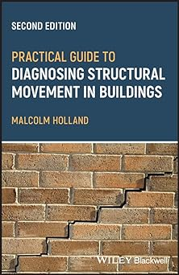
Practical Guide to Diagnosing Structural Movement in Buildings
PRACTICAL GUIDE TO DIAGNOSING STRUCTURAL MOVEMENT IN BUILDINGSConcise and readable practitioner focused guide to diagnosing the causes of cracks and movement in buildings
The expanded and updated Second Edition of Practical Guide to Diagnosing Structural Movement in Buildings shows how movement can manifest as cracking in the building fabric and provides a rigorous, structured approach to understanding the evidence to ensure the surveyor can confidently diagnose the cause and impact of any structural movement they encounter.
The book is written in four parts, with part one describing the key principles of movement and cracking. Parts two and three describe the main features of common forms of movement and the associated crack patterns, with part two covering causes other than ground or foundation movement and part three covering movement caused by ground or foundations. Part four briefly describes the techniques used to arrest further movement or repair damage caused by movement.
Topics covered in Practical Guide to Diagnosing Structural Movement in Buildings include:
First principles, including crack patterns and cracks, rotational movement, weak routes, load distribution, and movement and orientation
Expansion cracking, cavity wall tie corrosion, roof spread, springing from deflected beams, and overloaded floors and beams
Clay heave, uneven loading, eccentric loading on foundations, drains and drain trenches, differential foundation movement, and load concentrations on foundations
Repair methods, including stitching in brickwork, reinforcing brick mortar joints, tie bars, restraint straps, underpinning, grouting, and root barriers
Primarily intended for the relatively inexperienced surveyor or engineer, as well as undergraduate students, Practical Guide to Diagnosing Structural Movement in Buildings focuses on identification and diagnosis, helping to correctly diagnose problems while also demonstrating a methodical approach to show and record how the diagnosis was reached, which is critical in client satisfaction.

Slide 58
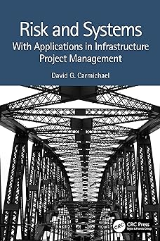
Risk and Systems
Risk is related to the magnitude and uncertainty of an output (consequence or outcome); outputs take on different identities in different disciplines and situations. Risk is peculiar to each stakeholder and the measurement scale for risk depends on the stakeholder's value system. Risk management provides a way of addressing the issues associated with the magnitude and uncertainty of outputs. This book provides a distinctively rational treatment of risk and risk management, based on a systems approach. The book's treatment applies to all disciplines and sets out the principles of risk and risk management as well as looking at a range of applications and more specialist tools and approaches. The book:
Develops a risk framework through a systems approach
Offers a challenging and fresh approach for infrastructure engineering, construction and project management in general
The book will suit students and practitioners alike.

Slide 59

Sciences industrielles de l'ingénieur MPSI - MP2I - PCSI - Programme 2021
Cet ouvrage a pour objectifs de permettre aux étudiants en MPSI, en PCSI ou en MP2I de réviser leur cours de SII (sciences industrielles de l'ingénieur) et de l'assimiler par la mise en application des notions. Dans chaque chapitre, correspondant à peu près à une semaine de cours, le lecteur trouvera notamment :
Le résumé de cours et les méthodes, pour assurer ses connaissances ;
Le vrai/faux pour tester sa compréhension du cours et éviter de tomber dans les erreurs classiques ;
Les exercices corrigés, souvent tirés de sujets d'annales, pour s'entraîner aux concours.
Avec un seul livre par année et par matière, la collection PRÉPAS SCIENCES vous guidera, jour après jour, dans votre cheminement vers la réussite aux concours

Slide 60

Thermodynamique chimique
Ce manuel contient l'essentiel du cours de la thermodynamique chimique (Energie interne, enthalpie, entropie, etc...) pour les étudiants du premier cycle universitaire. Afin de favoriser une assimilation rapide, j'ai donné des exercices corrigés bien détaillés. Enfin, j'espère que ce travail sera un outil efficace pour les étudiants.Je serai reconnaissant aux collègues et aux étudiants qui voudront faire part de leurs critiques, suggestions et remarques.

Slide 61

Traité d'horlogerie moderne
Il est des ouvrages dont la qualité et l’intérêt traversent les siècles, ce magnifique livre d’horlogerie en fait partie. Rédigé en 1872, ce Traité d’horlogerie moderne eut un succès retentissant auprès de la profession lors de sa publication. Considéré comme l’un des grands textes horlogers, il suscite encore notre admiration devant tant de génie à concevoir et à expliquer ces mouvements techniques de façon si détaillée, et réaliser avec une précision exceptionnelle ces dessins techniques avec autant de beauté. Cet ouvrage monumental se présente en trois parties : Traité des échappements, Traité des engrenages et Traité divers. La présentation du livre a été modernisée en insérant dans le texte la totalité des gravures et schémas (324) contenus dans les 21 planches placées à la fin de l’édition originale. Chaque figure a été ainsi nettoyée, rafraîchie, souvent agrandie, apportant plus de visibilité à la très grande qualité des détails et facilitant l’étude soutenue d’un livre aussi important. Apprécié des connaisseurs, il fait partie de la bibliothèque fondamentale de tous ceux qui s’intéressent à l’horlogerie. Auteur de plusieurs livres sur le sujet, Claudius Saunier (1816 – 1896), directeur de l’École d’horlogerie de Macon, fut le fondateur de la Revue Chronométrique, qui connût un franc succès.

Slide 62

Transferts thermiques - 6e éd. - Introduction aux transferts d'énergie
Les transferts thermiques sont une science clé de l’énergie. Cet ouvrage aborde les principaux modes de transferts d’énergie : la conduction, le rayonnement et la convection.Ces phénomènes très différents, mais pouvant interagir, doivent être connus de l’étudiant qui sera confronté un jour ou l’autre à un problème de transfert thermique. Il trouvera dans ce cours de nombreuses applications concrètes (centrales nucléaires, panneaux solaires, propulseur Vulcain...) ainsi que de nombreux exercices corrigés.Dans cette sixième édition entièrement actualisée, la priorité est donnée à la compréhension physique des phénomènes et à l’apprentissage de la modélisation physique. Le chapitre sur le rayonnement des milieux semi-transparents a été entièrement refondu pour intégrer des avancées récentes des concepts et des méthodes.

Slide 63
La sécurité logicielle Une approche défensive
La sécurité logicielle désigne l'ensemble des théories, des pratiques, des vérifications et des prudences que devraient utiliser les programmeurs afin que les systèmes qu'ils développent soient aussi sécuritaires que possible. Cet aspect de la sécurité informatique est souvent négligé. Cette attitude est regrettable, car, si le code d'un programme n'est pas développé avec soin, les stratégies de sécurité telles que la cryptographie ou les outils de sécurité des réseaux seront insuffisantes pour assurer la sécurité du système. Dans cet ouvrage, nous présentons les principes théoriques ainsi que les approches pratiques qui mènent à la création de codes robustes et sécuritaires. Nous utilisons une approche pédagogique originale par laquelle les principes sous-jacents à la sécurité des programmes sont illustrés par des exemples d'attaques réelles, et suivis de conseils que le programmeur peut mettre en pratique sans délai. Le livre présente aussi au lecteur les avancées scientifiques récentes de la recherche dans ce domaine.

Slide 64

L'eau et ses enjeux
« De l'eau qui pleut à l'eau qui coule », cet ouvrage nous fait découvrir pas à pas les différentes facettes de l'eau : liquide, solide, gazeux. Tous ces états de l'eau, que l'on retrouve au cours de son cycle, sont abordés par l'auteur en lien avec les interactions naturelles et les besoins humains.Répartie de manière inégale sur terre, les enjeux de l'eau pour le XXIe siècle sont multiples : les fortes demandes des mégalopoles, le réchauffement climatique, le manque d'eau, les maladies hydriques, les inondations, la sécheresse, etc. Si l'eau doit répondre à des enjeux, les hommes doivent, eux, remplir des défis : apprendre à partager cette ressource, fournir une eau salubre à tous, gérer les manques et les surplus.Dans cette nouvelle édition, l'accent est mis sur la gouvernance de l'eau, la COP21, l'acidification des océans, et l'ensemble de l'ouvrage a été mis à jour : statistiques, données, etc.

Slide 65
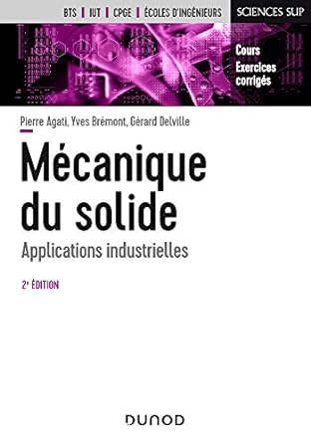
Mécanique du solide - 2e éd. - Applications industrielles
Cet ouvrage de mécanique générale s'adresse aux étudiants de l'enseignement technique supérieur. Il trouve son originalité dans le choix des applications qui couvrent tous les mécanismes industriels. Cette deuxième édition est une refonte complète de la 1re édition. Avec plus de travaux pratiques et des liens plus étroit avec le concret et la pratique, l'observation et l'analyse. Des chapitres du cours ont été remaniés pour être davantage en adéquation avec les programmes (modélisation et paramétrage des mécanismes, hyperstatisme,
Une erreur s'est glissée lors de la dernière réimpression de l'ouvrage, les pages 86 et 87 sont manquantes. Veuillez nous excuser pour cette gêne et retrouver les pages manquantes dans les compléments en accès libre.

Slide 66
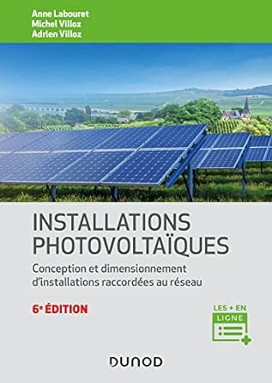
Installations photovoltaïques - 6e éd. Conception et dimensionnement d'installations raccordées au réseau
Domaine stratégique de la transition énergique, le photovoltaïque est au coeur des objectifs gouvernementaux qui visent une augmentation régulière de sa part dans la production d’électricité en France. Cet ouvrage, axé sur la pratique, donne toutes les clés pour choisir, assembler et entretenir les installations solaires photovoltaïques raccordées au réseau. Il se révélera un outil indispensable aux ingénieurs, concepteurs, chefs de projet, donneurs d’ordre et intervenants techniques du solaire.Cette sixième édition, entièrement revue et actualisée, présente la conversion photovoltaïque et la technologie des panneaux solaires, décrit les équipements utilisés, ainsi que leur installation puis détaille la conception de projets basse puissance et de centrales à forte puissance. Enfin, elle aide au contrôle et à la maintenance des systèmes photovoltaïques. Des annexes sur les données d’ensoleillement et les acteurs du secteur complètent l’ouvrage.

Slide 67
De la chimie des solutions à lélectrochimie - Thermodynamique et cinétique électrochimiques
Cet ouvrage présenteles bases de la thermodynamique et la cinétique électrochimiques, illustrées de nombreux exemples de générateurs et d’électrolyseurs industriels et accompagnées d’exercices corrigés.
Il s'adresse aux étudiants en licence, master, élèves des CPGE, élèves-ingénieurs, candidats au CAPES et à l’agrégation, et tout autodidacte intéressé par le stockage et l’utilisation de l’énergie électrique.

Slide 68
Essential Ordinary Differential Equations
This textbook offers an engaging account of the theory of ordinary differential equations intended for advanced undergraduate students of mathematics. Informed by the author's extensive teaching experience, the book presents a series of carefully selected topics that, taken together, cover an essential body of knowledge in the field. Each topic is treated rigorously and in depth.The book begins with a thorough treatment of linear differential equations, including general boundary conditions and Green's functions. The next chapters cover separable equations and other problems solvable by quadratures, series solutions of linear equations and matrix exponentials, culminating in Sturm-Liouville theory, an indispensable tool for partial differential equations and mathematical physics. The theoretical underpinnings of the material, namely, the existence and uniqueness of solutions and dependence on initial values, are treated at length. A noteworthy feature of this book is the inclusion of project sections, which go beyond the main text by introducing important further topics, guiding the student by alternating exercises and explanations. Designed to serve as the basis for a course for upper undergraduate students, the prerequisites for this book are a rigorous grounding in analysis (real and complex), multivariate calculus and linear algebra. Some familiarity with metric spaces is also helpful. The numerous exercises of the text provide ample opportunities for practice, and the aforementioned projects can be used for guided study. Some exercises have hints to help make the book suitable for independent study.

Slide 69

Les nanoparticules d'argent Facteurs cinétiques, anticancéreux et antimicrobiens
Les nanoparticules d'argent signifient que les particules d'argent ont une taille comprise entre 1 et 100 nm. Le développement rapide et efficace de la synthèse des nanoparticules d'argent (Ag NPs) est dû à sa large application dans divers domaines, tels que l'anticancéreux, l'antibactérien, l'antifongique et comme catalyseur. Ce livre fournit au lecteur une introduction actualisée sur les nanomatériaux et leurs nanostructures et nous fera découvrir des détails précis et nouveaux sur les expériences visant à déterminer les études cinétiques pour la préparation de nanoparticules d'argent à l'aide d'une méthode de nanosynthèse basée sur la biologie. De plus, le livre comprend les expériences d'utilisation de ces nanoparticules dans le traitement du cancer et des microbes et la manière d'évaluer leur activité

Slide 70
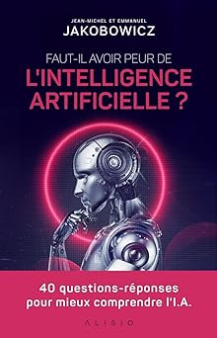
L'Intelligence artificielle, une révolution
D'où vient le terme « intelligence artificielle » ? Peut-on vraiment parler d'« intelligence artificielle » ? Qu'est-ce que le Big Data, le deep learning ou le machine learning ? L'intelligence artificielle est-elle nouvelle ? Que va-t-elle réellement changer dans nos vies ? Faut-il en avoir peur ?
En ce début de xxie siècle, l'intelligence artificielle semble être de tous les débats et alimenter tous les catastrophismes. On nous explique qu'elle pourrait bien prendre la main sur l'humanité voire s'en débarrasser dans un proche avenir. Mais elle est aussi à l'origine de progrès techniques et scientifiques remarquables qui font d'elle un assistant omniprésent dans nos vies, bien souvent sans que nous y prêtions attention. Cet ouvrage ne vous propose pas de prendre parti pour ou contre l'intelligence artificielle mais vous donnera toutes les clés pour mieux la comprendre et vous en faire une opinion informée.
Entre science, fiction et marketing, l'intelligence artificielle est-elle vraiment cette révolution que certains redoutent et que d'autres espèrent ?

Slide 71

LTE for Public Safety
The aim of the book is to educate government agencies, operators, vendors and other regulatory institutions how LTE can be deployed to serve public safety market and offer regulatory / public safety features. It is written in such a way that it can be understood by both technical and non-technical personnel with just introductory knowledge in wireless communication. Some sections and chapters about public safety services offered by LTE network are intended to be understood by anyone with no knowledge in wireless communication.

Slide 72

Particles and Nuclei An Introduction to the Physical Concepts
This well-known introductory textbook gives a uniform presentation of nuclear and particle physics from an experimental point of view.The first part, Analysis, is devoted to disentangling the substructure of matter. This part shows that experiments designed to uncover the substructures of nuclei and nucleons have a similar conceptual basis, and lead to the present picture of all matter being constructed from a small number of elementary building blocks and a small number of fundamental interactions.
The second part, Synthesis, shows how the elementary particles may be combined to build hadrons and nuclei. The fundamental interactions, which are responsible for the forces in all systems, become less and less evident in increasingly complex systems. Such systems are in fact dominated by many-body phenomena. A section on neutrino oscillations and one on nuclear matter at high temperatures bridge the field of "nuclear and particle physics" and "modem astrophysics and cosmology.
The seventh revised and extended edition includes new material, in particular the experimental verification of the Higgs particle at the LHC, recent results in neutrino physics, the violation of CP-symmetry in the decay of neutral B-mesons, the experimental investigations of the nucleon's spin structure and outstanding results of the HERA experiments in deep-inelastic electron- and positron-proton scattering. The concise text is based on lectures held at the University of Heidelberg and includes numerous exercises with worked answers. It has been translated into several languages and has become a standard reference for advanced undergraduate and graduate courses.

Slide 73

Solar Surveyors Observing the Sun from Space (Springer Praxis Books)
This is the story of humankind’s quest over centuries to learn the true nature of the most dominant object in our Solar System: the Sun.
Award-winning science writer Peter Bond describes in detail how our ideas about the Sun have changed over the millennia, starting with the simple observations of classical astronomy and continuing through telescopic observations to the age of nuclear physics. He shows how we discovered the Sun’s basic characteristics – its distance, size, temperature and composition – and then describes how, with evermore sophisticated instruments, we have learned about the Sun’s enormous energy output, its atmosphere and the explosive eruptions that blast clouds of magnetized gas and high-energy particles toward our world.Most of this book focuses on the Space Age, when suborbital rockets and satellites have probed every aspect of our nearby star. Each of these missions is described in detail, with summaries of their objectives, spacecraft designs, scientific payloads and results. The book also looks forward, describing forthcoming missions that will shed new light on remaining solar mysteries, notably the source of the energy that heats the outer corona to millions of degrees.Richly illustrated with mission photos, design diagrams, and infocharts, this book is a fascinating read for anybody interested in the Sun and our attempts to unravel its secrets.

Slide 74

Traitement numérique du signal
Les techniques numériques apportent dans le domaine du traitement du signal des possibilités prodigieuses. Cependant, elles présentent un certain degré d’abstraction et leur application aux cas concrets requiert des connaissances théoriques qui peuvent représenter un obstacle. L’ambition de cet ouvrage est de faire le lien entre la théorie et la pratique, et de mettre à la portée du plus grand nombre les résultats les plus utiles dans ce domaine.Tenant compte des techniques les plus récentes, cette dixième édition propose des applications pratiques et des exercices corrigés qui permettront au lecteur de valider de manière concrète ses acquis.

Slide 75
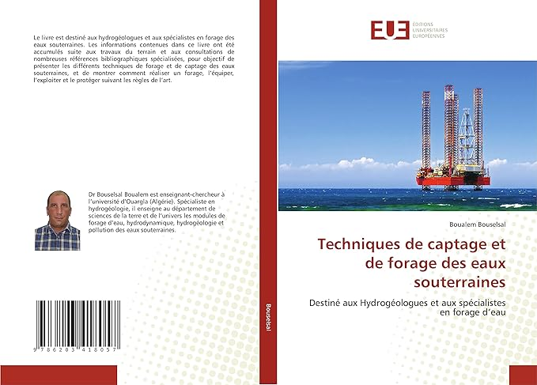
Techniques de captage et de forage des eaux souterraines

Slide 76

Pharmacologie des médicaments

Slide 77

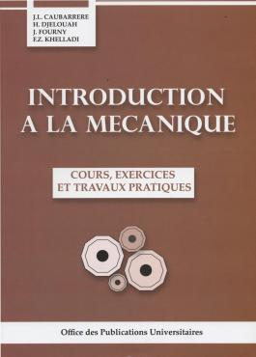

Slide 78



Slide 79
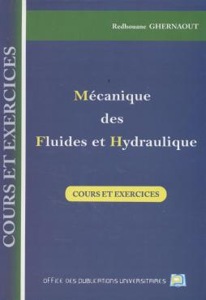
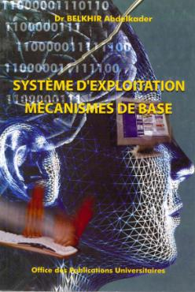

Slide 80



Slide 81
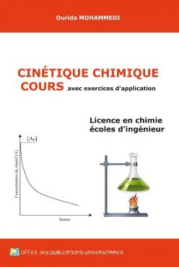


Slide 82
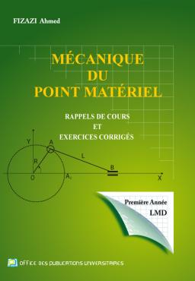
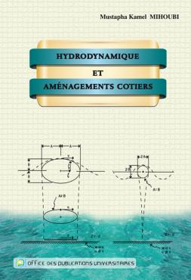

Slide 83
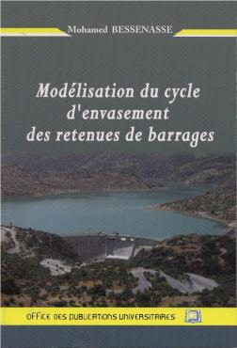

Slide 84



Slide 85
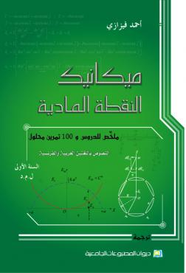
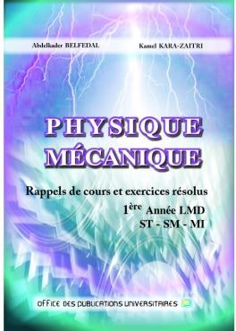

Slide 86



