Slide 1























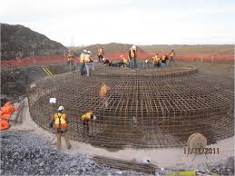


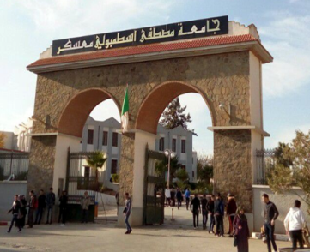
People’s Democratic Republic of Algeria
Ministry of Higher Education and Scientific Research
🏛 Organized by Mustapha STAMBOULI University, Mascara
Faculty of Sciences and Technology
Department of Civil Engineering
NCCEMI’26
ST
📢Call for participation 2026
Mascara 2026
The First National Conference on Civil Engineering and Materials Innovation (NCCEMI’26) - Mascara, Algeria – September, 2026
📍 Mascara, Algeria 📅 September 29, 2026

Slide 2

👤 Conference Leadership
President of the Conference Dr. Ali MEKSI
Honorary Presidents Pr. Younes MOUCHAAL (University President) Pr. Hadj Miloud MEDDAH (Dean of the Faculty)
President of the Scientific Committee Pr. Mohamed SADOUN
President of the Organizing Committee Dr. Khaled BELMAHDI
📚 Conference Overview
The First National Conference on Civil Engineering and Materials Innovation (NCCEMI’26) aims to bring together researchers, academics, and industry professionals to discuss recent advances and emerging trends in civil engineering and materials science.
The conference will focus on innovative approaches in structural engineering, advanced materials, geotechnics, and environmental engineering, with particular emphasis on performance, durability, and risk mitigation in modern infrastructures.
🎯 Objectives
The main objectives of the conference are:
To provide a platform for researchers and practitioners to exchange knowledge and expertise
To present and discuss recent scientific and technical advances
To strengthen collaboration between universities and the industrial sector
🧩 Main Topics
Structural Engineering and Dynamic Stability
Advanced and Composite Materials
Geotechnical and Environmental Engineering
📅 Important Dates
Call for Participation: June 1, 2026
Paper Submission Deadline: June 20, 2026
Notification of Acceptance: June 30, 2026
Conference Date: September 30, 2026
📝 Submission Guidelines
Papers must be written in Arabic, English, or French
Maximum length: 6 pages, including figures, tables, and references
Format: NCCEMI’26 template
Submission via email: 📧 sngce-2026@univ-mascara.dz
🧑‍🔬 Scientific Committee
Pr | YOUZERA Hadj | UMS Mascara
Pr | SENHADjI yassine | UMS Mascara
Pr | TOUNSI Abelouhed | UDL Sidi Bel A
Pr | RAHAL Nacer | UMS Mascara
Pr | Gaidi Laouni | UMS Mascara
Pr | BELAKHDR Khalil | CUTamanrasset
Pr | HEBALI Habib | UMS Mascara
Pr | ABDELHAK zohra | UAZ Relizane
Pr | BALEGH Benamer | UAD Adrar
Pr | HADJ ADDA M | UAZ Relizane
Pr | SALLAF Hamid | UMT Saida
Pr | ZIDOUR Mohamed | UIK Tiaret
Pr | HAMIDI Ahmed | UTM Bechar
Pr | CHIKH Abdelbaki | UIK Tiaret
Pr | KADA Draiche | UIK Tiaret
Dr | BENHMED Abd | CUNB El Bayadh
Dr | SOUICI Aziz | UMS Mascara
Dr | BOUGNINA Otbi | CUNB El Bayadh
Dr | BAGHDAD Houda | UMS Mascara
Dr | REMIL Aicha | UMS Mascara
Dr | ZEMRI Cheikh | UMS Mascara
Dr | OULHA Yazud | UMS Mascara
⚙️ Technical Committee
Dr | HANTRI Mohamed | UMS Mascara
Dr | BERKHROUKH Nadjet | UMS Mascara
Dr | ZEGGA Kaddour | UMS Mascara
Dr | CHAOUCH Djamel eddine | UMS Mascara
Pr | SIAD Amaria | UMS Mascara
Dr | Driss Miloud | UMS Mascara
Dr | REFFAS Soria | UMS Mascara
Dr Dr Dr | DJIDAR Fatima Zohra Drai Ismail BENAOUM Fatima | UMS Mascara UMS Mascara UMS Mascara

